Slide 1

Terrorism in the Middle East

Slide 2
Background
Modern Islamic Terrorism can be traced back to the 19th century.
Many Islamic nations harbor ill feelings toward the United States and the UN due to Cold War tensions, as many Middle Eastern countries were Soviet satellite nations.
Many Islamic terrorist cells wish to see the death of Capitalist-Democratic nations.

Slide 3
Current Terrorism
Insurgent forces remain active throughout the Middle East, despite the UN’s best efforts.
With the deaths of Saddam Hussein and Osama bin Laden, the insurgent cells are less effective.
With the United States withdrawal from Iraq, a spike in insurgent activity would not be unexpected.

Slide 4
UN Impact
The United Nations have enacted doctrines related to terrorism and counter-terrorism.
The goals of these doctrines is to eradicate terrorism and to restore human rights to the Middle East.
These doctrines also serve as a way to bring light to the turmoil in the Middle East.

Slide 5
Future Terrorism
With the way things are going in the Middle East, it is safe to say that there is no end in sight for terrorism.
As long as the Sunni and Shia (extremist religious factions) exist in the Middle East, they will continue to terrorize citizens.
In the past decade, cyber-terrorism has become increasingly popular. Cyber-terrorists can hack into important security systems and cause terror on a grand scale.

Slide 6
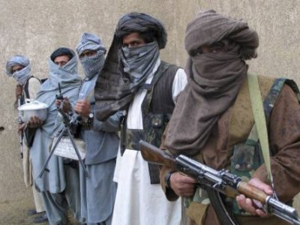

Slide 7
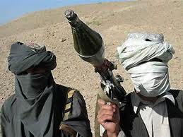

Slide 8


Slide 9


Slide 10


