Slide 1
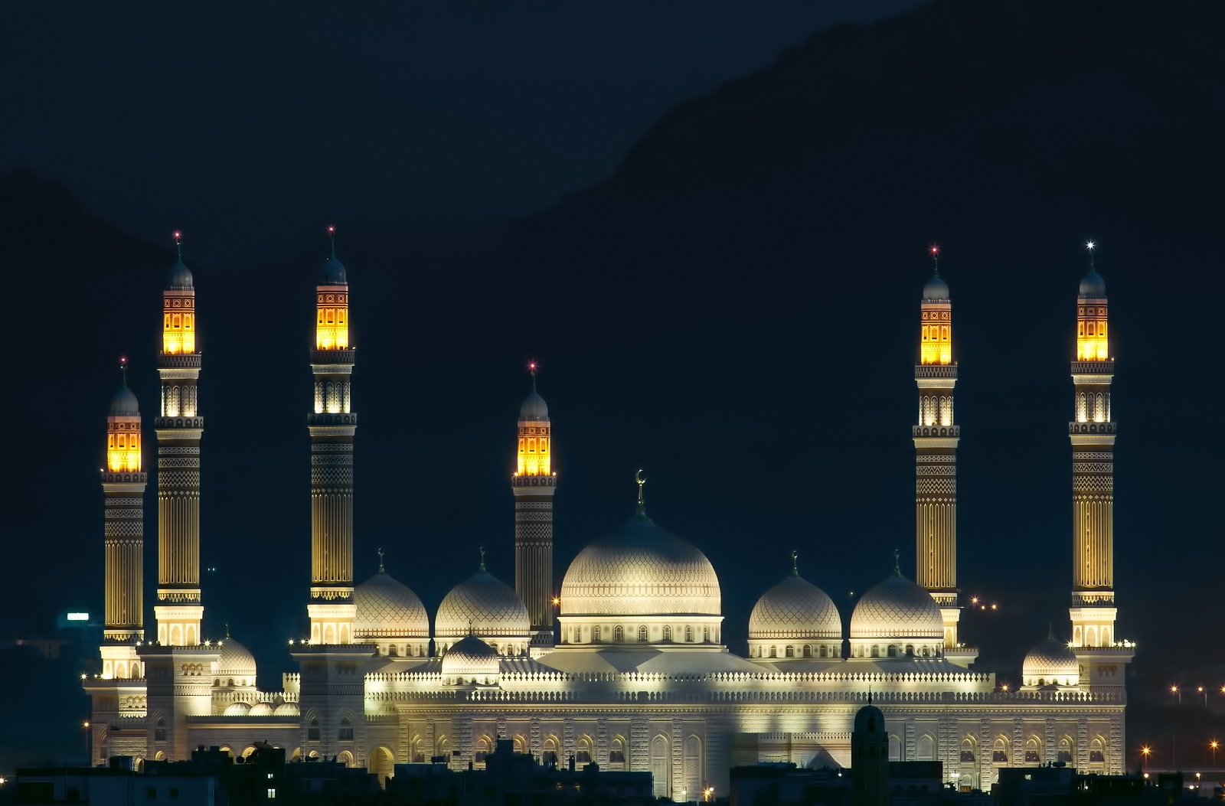
CHANGE IN
THE MIDDLE EAST!
By: Sam Iles

Slide 2

Tunisia
Tunisia is currently in a state of revolution.
The revolution was literally sparked by 26-year old Mohamed Bouazizi, when he set himself on fire in protest of the harsh tactics of the law enforcement. Citizens of Tunisia began violent demonstrations against the government shortly thereafter.
On January 14, 2011, Tunisia’s president stepped down after leading the nation for 23 years.
A transitional government was formed, led by Mohammed Ghannouchi. This government banned the former ruling party from the nation.

Slide 3

Algeria
In December 1991 the Front Islamique du Salut, a broad coalition of Islamist groups, dominated the first of two rounds of legislative elections.
Algeria held elections in 1999, which were won by President Abdelaziz Bouteflika. Bouteflika focused on restoring stability to the country following his election and announced a ‘Civil Concord’ initiative, approved in a referendum, under which many political prisoners were pardoned, and several thousand members of armed groups were granted exemption from prosecution under a limited amnesty which was in force up to 13 January 2000.
A continuing series of protests throughout the country started on 28 December 2010, inspired by similar protests across the Middle East and North Africa. On 24 February 2011, Algeria's 19-year-old state of emergency was lifted. Several pieces of legislation were enacted dealing with political parties, the electoral code and the representation of women in elected bodies. In April 2011, Bouteflika promised further constitutional and political reform.

Slide 4

Egypt
On 25 January 2011, widespread protests began against Mubarak's government. On 11 February 2011, Mubarak resigned and fled Cairo. Jubilant celebrations broke out in Tahrir Square at the news. The Egyptian military then assumed the power to govern.
A constitutional referendum was held on 19 March 2011. On 28 November 2011, Egypt held its first parliamentary election since the previous regime had been in power. Turnout was high and there were no reports of major irregularities or violence. Mohamed Morsi was elected president on 24 June 2012.
On 2 August 2012, Egypt’s Prime Minister Hisham Qandil announced his 35 member cabinet comprising 28 newcomers including four from the Muslim Brotherhood.
Liberal and secular groups walked out of the constituent assembly because they believed that it would impose strict Islamic practices, while Muslim Brotherhood backers threw their support behind Morsi. The move has led to massive protests and violent action throughout Egypt.

Slide 5
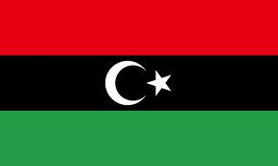
Libya
After the Arab Spring movements overturned the rulers of Tunisia and Egypt, Libya experienced a full-scale revolt beginning on 17 February 2011.
Organs of the United Nations, including United Nations Secretary General Ban Ki-moon and the United Nations Human Rights Council put their support behind the rebels.
By 22 August 2011, rebel fighters had entered Tripoli and occupied Green Square, which they renamed Martyrs' Square in honor of those killed since 17 February 2011.
The "liberation" of Libya was celebrated on 23 October 2011. At least 30,000 Libyans died in the civil war.
On 7 July 2012, Libyans voted in their first parliamentary elections since the end of Gaddafi's rule. On 8 August 2012, the National Transitional Council officially handed power to the wholly elected General National Congress.
On 7 October 2012, Libya's Prime Minister-elect Mustafa A.G. Abushagur stepped down after failing a second time to win parliamentary approval for a new cabinet. On 14 October 2012, the General National Congress elected former GNC member and human rights lawyer Ali Zeidan as prime minister-designate. Zeidan will be sworn in after his cabinet has been approved by the GNC.

Slide 6

Saudi Arabia
In 2005, King Fahd, leader of Saudi Arabia, died and was succeeded by Abdullah, who continued the policy of minimum reform and clamping down on protests. The king introduced a number of economic reforms aimed at reducing the country's reliance on oil revenue: limited deregulation, encouragement of foreign investment, and privatization. In February 2009, Abdullah announced a series of governmental changes to the judiciary, armed forces, and various ministries to modernize these institutions including the replacement of senior appointees in the judiciary and the Mutaween (religious police) with more moderate individuals and the appointment of the country's first female deputy minister.
On 29 January 2011, hundreds of protesters gathered in the city of Jeddah in a rare display of criticism against the city's poor infrastructure after deadly floods swept through the city, killing eleven people. Police stopped the demonstration after about 15 minutes and arrested 30 to 50 people.
In 2011 and 2012 Saudi Arabia was affected by its own Arab Spring protests. In response, King Abdullah announced a series of benefits for citizens amounting to $10.7 billion. No political reforms were announced as part of the package, though some prisoners indicted for financial crimes were pardoned. Although male-only municipal elections were held on 29 September 2011. Abdullah announced that women will be able to vote and be elected in the 2015 municipal elections, and also to be nominated to the Shura Council.

Slide 7
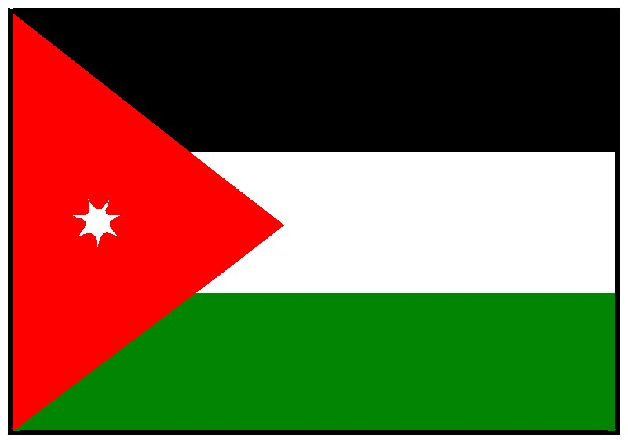
Jordan
In response to domestic and regional unrest, in February 2011 King Abdallah replaced his prime minister and formed a National Dialogue Commission with a reform mandate. The King told the new prime minister to "take quick, concrete and practical steps to launch a genuine political reform process", "to strengthen democracy," and provide Jordanians with the "dignified life they deserve." The King called for an "immediate revision" of laws governing politics and public freedoms. Initial reports say that this effort has started slowly and that several "fundamental rights" are not being addressed.

Slide 8
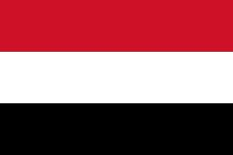
Yemen
In March 2011, police snipers opened fire on the pro-democracy camp in Sana'a, killing more than 50 people. On 23 November 2011, Saleh flew to Riyadh, in neighboring Saudi Arabia, to sign the Gulf Co-operation Council plan for political transition, which he had previously spurned. Upon signing the document, he agreed to legally transfer the office and powers of the presidency to his deputy, Vice President Abd Rabbuh Mansur Hadi. Hadi took office for a two-year term upon winning the uncontested presidential elections in February 2012.By 2012 there has been a "small contingent of U.S. special-operations troops" in addition to CIA and "unofficially acknowledged" U.S. military presence in response to increasing terror attacks by AQAP on Yemeni citizens. Former president Saleh continues to hinder the new government effort as his sons are still running security sectors in the country.

Slide 9

Syria
In a major shift in relations with both other Arab states and the Western world, Syria participated in the US-led Gulf War against Saddam Hussein. Syria participated in the multilateral Madrid Conference of 1991, and during the 1990s engaged in negotiations with Israel. These negotiations failed, and there have been no further direct Syrian-Israeli talks since President Hafez al-Assad's meeting with then President Bill Clinton in Geneva in March 2000. Hafez al-Assad died on 10 June 2000. His son, Bashar al-Assad, was elected President in an election in which he ran unopposed. His election saw the birth of the Damascus Spring and hopes of reform, but by autumn 2001 the authorities had suppressed the movement, imprisoning some of its leading intellectuals. Instead, reforms have been limited to some market reforms. On 5 October 2003, Israel bombed a site near Damascus, charging it was a terrorist training facility for members of Islamic Jihad. In March 2004, Syrian Kurds and Arabs clashed in the northeastern city of al-Qamishli. Signs of rioting were seen in the towns of Qameshli and Hassakeh. The ongoing Syrian civil war was inspired by the Arab Spring Revolutions. It began in 2011 as a chain of peaceful protests, followed by a crackdown by the Syrian Army. In July 2011, army defectors declared the formation of the Free Syrian Army and began forming fighting units. The opposition is dominated by Sunni Muslims, whereas the leading government figures are Alawites. According to various sources, including the United Nations, up to 60,000 people have been killed. To escape the violence, over 650,000 Syrian refugees have fled to neighboring countries of Jordan, Iraq, Lebanon, and Turkey. As the civil war nears its second year, there have been worries that the country could become fragmented and cease to function as a state.

Slide 10
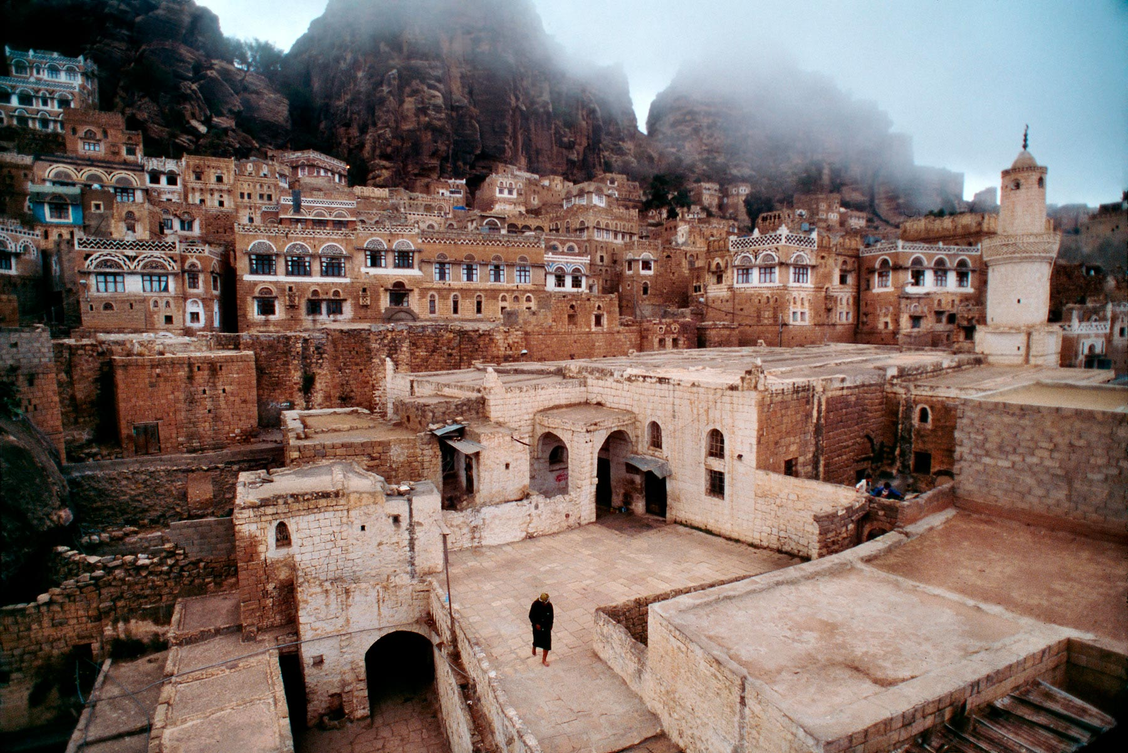
US Involvement in Yemen
The United States are already slightly involved with the affairs in Yemen.
Small contingencies of U.S. troops and CIA operators are currently overseeing the implementation of a democratic government.
The former tyrant continues to impede progress in the transition of governments.

